Slide 1
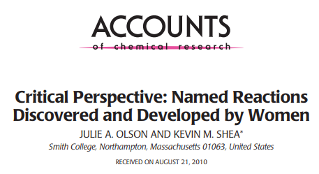
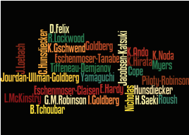



doi.org/10.1021/ar100114m
doi.org/10.1021/ar2002478

Slide 2
Q1
NAMED
Jourdan-Ullman-Goldberg Reaction (1906)
Irma Goldberg
Born in Moscow (1871)
Studied chemistry at Geneva University and joined the Fritz Ullmann group in the 1890s
Goldberg married Ullmann in 1910

Slide 3
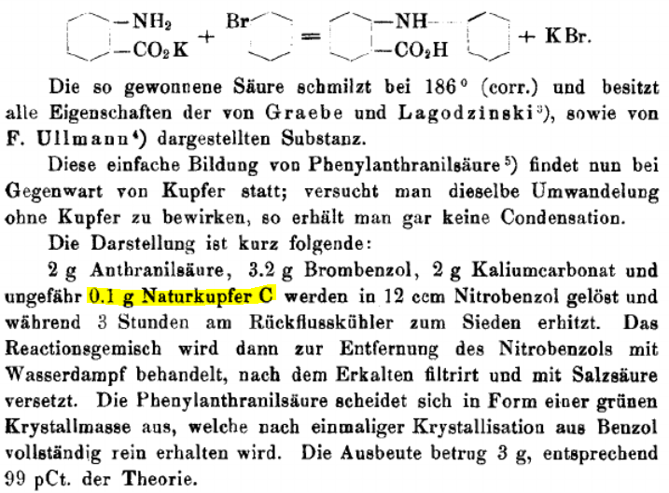
Q1

Slide 4
Q2
NAMED
Piloty-Robinson Pyrrole Synthesis (1918)
Gertrude Maud Walsh
Born in 1886 and
Obtained her undergraduate and master’s degrees (Chemistry) at the University of Manchester
Worked as a research assistant in Chaim Weizmann's lab at Manchester
Walsh met a graduate student in William Perkin's lab named Robert Robinson. They were married in 1912 and embarked on a voyage to Robert Robinson's first academic post at the University of Sydney, Australia. The Robinsons began their research partnership in Sydney which continued upon their return to Britain in 1915.

Slide 5
Q2

Slide 6
Q3
NAMED
Hunsdiecker Reaction (1939)
Clare Dieckmann
Born in Kiel, Germany (1903)
Completed her PhD in chemistry in 1928 at the University of Cologne, Germany.
She and her husband, Heinz Hunsdiecker, both conducted graduate research in Cologne in the research lab of Prof. R. Wintgen and were married in 1931. The Hunsdieckers were both hired by Egon Vogt of Chemische Fabrik Dr. Vogt & Co., where they developed the reaction that came to bear their name.

Slide 7
Q3

Slide 8
Q4
DISCOVERED/DEVELOPED
Tiffeneau-Demjanov Rearrangement (1937)
Bianka Tchoubar
Born in Ukraine (1910) and immigrated with her family to France in 1924.
Completed her undergraduate degree in chemistry at the Sorbonne in Paris in 1931.
Obtained a master's degree from the University of Paris in 1932.
Joined Marc Tiffeneau's research group at the Medical School in Paris. She quickly rose in stature in Tiffeneau's lab and soon directed her own research students, headed the Organic Chemistry Laboratory and gained a research appointment at the newly created Centre National de la Recherche Scientifique (CNRS). She worked on the development of the Tiffeneau-Demjanov rearrangement. Tiffeneau died in 1945. Tiffeneau later published a thesis including this work. Tchoubar's mechanistic hypothesis for the rearrangement step involved generation of diazonium ion from combination of the amine and nitrous acid. Loss of nitrogen yields carbocation, which quickly rearranges to the enlarged ketone followed by a proton transfer step.
Tchoubar was the intellectual and experimental driving force behind the development of this reaction, and it is truly unfortunate that her exploits were not recognized as the Tchoubar rearrangement

Slide 9
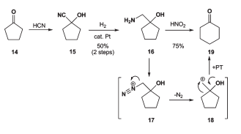
Q4

Slide 10
Q5
DISCOVERED/DEVELOPED
Cope Rearrangement (1940)
Elizabeth Hardy
- In the 1930s, Arthur C. Cope's research group at Bryn Mawr College studied alkylation reactions of allylic enolates.
Elizabeth Hardy, a graduate student at Bryn Mawr, investigated one substrate in the series under examination and soon discovered what is now known as the Cope rearrangement.
Hardy's contributions were clearly significant, but Cope is immortalized singularly because of his continued development of the reaction with numerous other co-workers.

Slide 11
Q5

Slide 12
Q6
DISCOVERED/DEVELOPED
Eschenmoser-Claisen Rearrangement (1964)
Dorothee Felix
Earned her diploma in 1955 and PhD in 1959 at the Swiss Federal Institute of Technology (ETH).
She conducted her graduate research in Albert Eschenmoser's lab and became a critical member of Eschenmoser's research team for the next four decades.
Katharina Gschwend
Completed her undergraduate studies at the ETH in 1962 and then joined the research group of Albert Eschenmoser for her graduate work.
In 1964, Felix and Gschwend reported a modification of the Claisen rearrangement that furnished unsaturated amides in high yields and stereoselectivities.
Originally discovered by Alexander Wick
during his PhD (finished 1964)

Slide 13
Q6

Slide 14
Q7
DISCOVERED/DEVELOPED
Yamaguchi Macrolactonization (1979)
Kuniko Hirata
- Obtained her bachelor's and master's degrees from Kyushu University in 1976 and 1978, respectively.
Hiroko Saeki
- No info
Joined a team of chemists under the direction of Yamaguchi who focused on generating mixed
anhydrides in the presence of DMAP to promote lactonization.
Hirata, Saeki, and co-workers synthesized a variety (more than 15) of mixed anhydrides bearing substituted benzene rings and determined that both anhydride formation and lactonization were favoured when starting with 2,4,6-trichlorobenzoyl chloride. They demonstrated the utility of this strategy starting with several unfunctionalized hydroxy acids.
Yamaguchi, as the head of the lab, is given sole recognition in the name of this reaction.

Slide 15
Q7

Slide 16
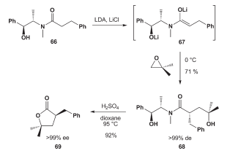
Q8
DISCOVERED/DEVELOPED
Myers Asymmetric Alkylation (1994)
Lydia McKinstry
Completed her Ph.D. in 1994 at Montana State University with Thomas Livinghouse
Joined the Andrew Myers lab as a postdoc in 1994 (Caltech)
McKinstry's investigations with the results of four other members of the Myers lab, enabled publication of the key Myers alkylation paper in 1997.
McKinstry's contributions were not recognized by inclusion with Myers in the name of this reaction because she played a small part in the development of the wide scope of this transformation

Slide 17
Q8

